Slide 1
The need for Virtual Reality in anatomy education
Cadavers
Expensive
Decreasing availability
Decay
Ethical issues
Difficult to prosect cadavers to observe certain relationships
Restricted by time and location
2D atlases (textbooks)
Compromises 3D/spatial comprehension

Slide 2
The benefits of Virtual Reality
‘Virtual Reality … transfers the learning experience from one that involves the memorising the structures without a true understanding of the 3-Dimensional relations, to a process that involves a thorough understanding of the structure based on visualisation rather than memorising, which makes the learning process more efficient and enjoyable, and less time consuming.’ (Falah, J et al. 2014)

Slide 3
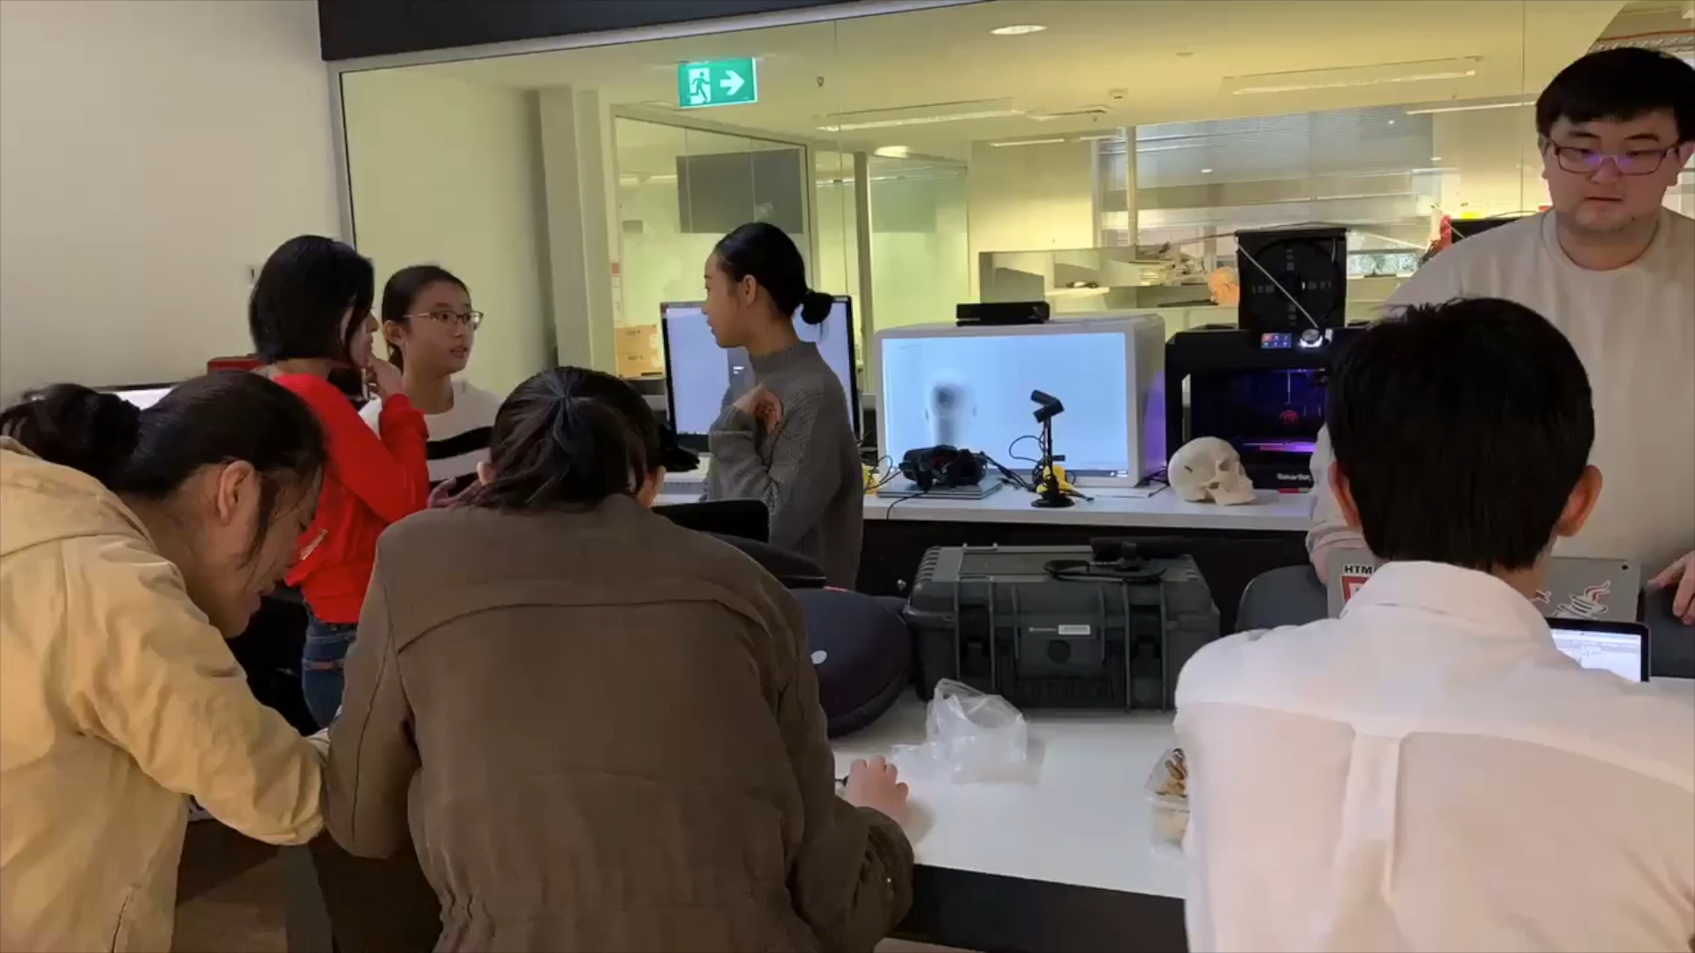
Process

Slide 4
Demonstration
Zoom allows different perspectives
Independent learning
Multiplayer feature for student-student and student-teacher collaboration

Slide 5
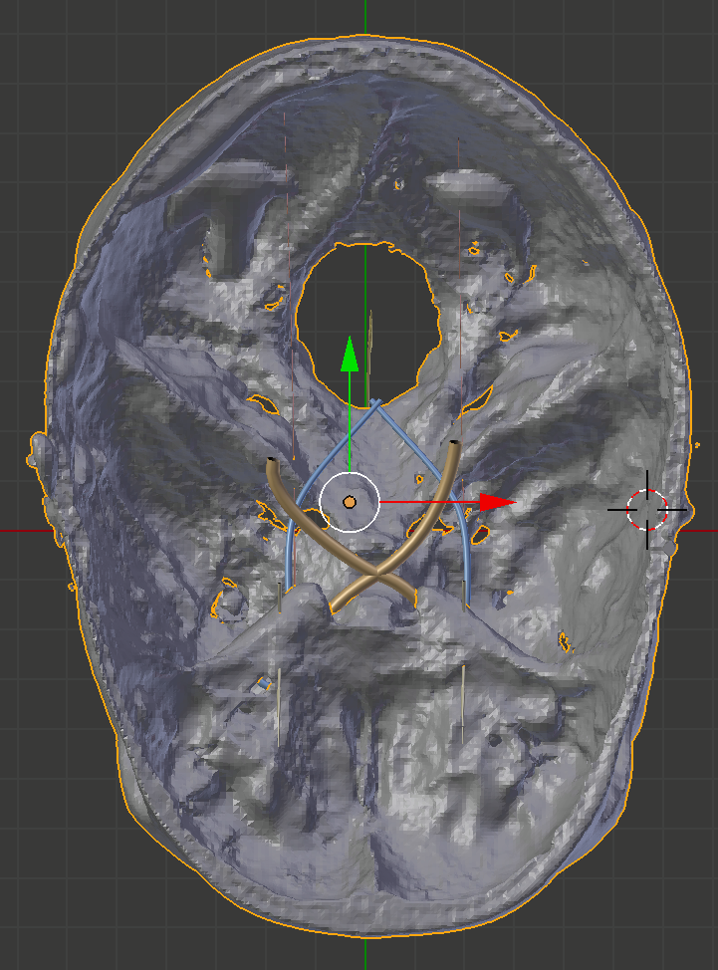
Improvements
Educational
Option to choose and isolate layers
Cross-sections
Guided animated walkthrough
Quizzes
Anatomical
Addition of more anatomical structures
Top View

Slide 6
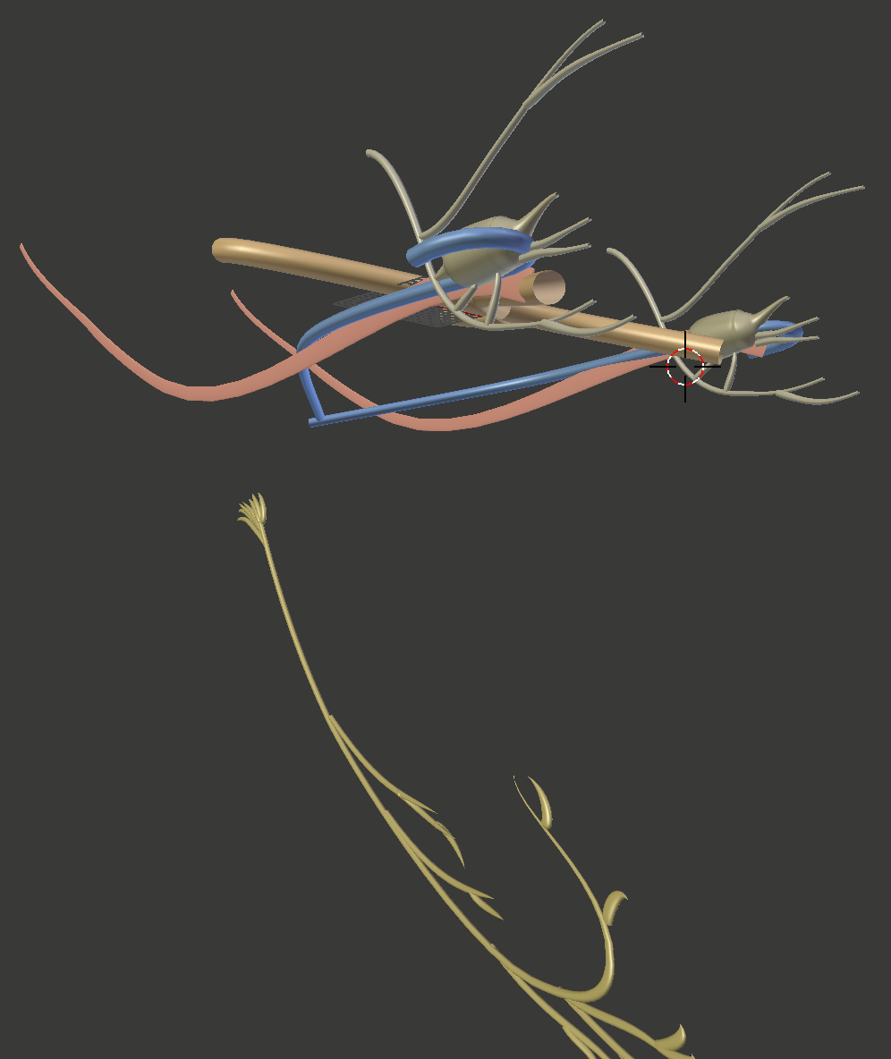
Significance
VR is already used in medical training
Future directions
Personalise skulls for preoperative training
Other body parts
User Perspective of Cranial Nerves

Slide 7
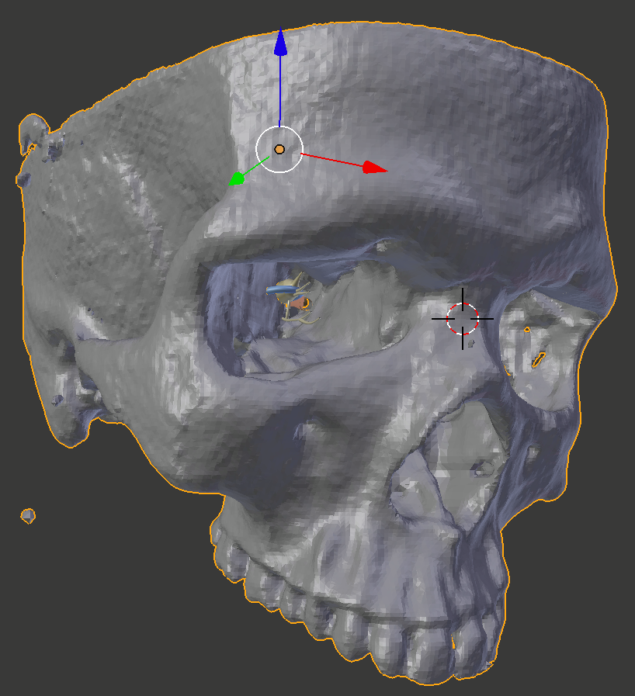
Summary
Practical
Accessible
Flexible
Educational
Spatial comprehension
User Perspective

